Slide 1
Introduction to Sequencing Technologies
Manpreet Katari

Slide 2
Outline
Why do we sequence ?
Genome Annotation
Comparative Genomics
Expression Profiling
Mapping variation: SNPs, other mutations
Evolution of Sequencing Technology
Faster, cheaper, deeper sampling

Slide 3
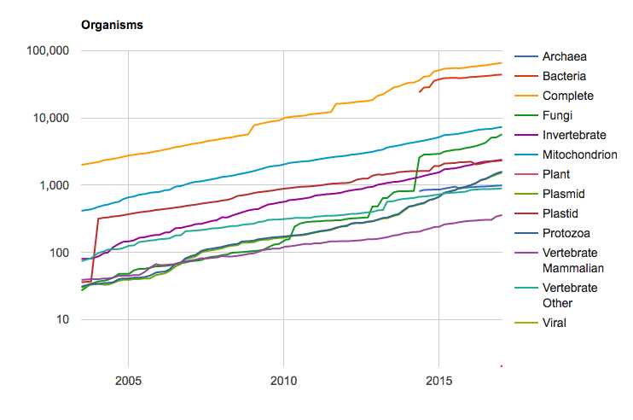
Number of Species being sequenced
https://www.ncbi.nlm.nih.gov/refseq/statistics/

Slide 4
Examples of Large Genome Projects
1001 Arabidopsis thaliana Genomes Project (www.1001genomes.org) . Study the genomes and phenotypes of 1001 accession that can explain difference in phenotype caused by adaptation to different conditions.
Metagenomics – Human Microbiome Project (http://commonfund.nih.gov/hmp/): Sequencing of DNA samples from environments, for example mouth, skin, and digestive system, to identify the different bacterial species present.

Slide 5

All of us – an NIH initiative

Slide 6
Evolution of Sequencing Technology
1977
1986
2000's
Method
Sanger sequencing (manual)
Automated Sanger sequencing
Lee Hood (first semi-automated machine)
99.999% accuracy
$0.50/kilobase
Cyclic array sequencing
sequencing by synthesis
sequencing by hybridization
Throughput
Tens of thousands of bp per person-year
~400-500bp/run
Thousands of bp per run (multiplexed) ~ millions of bp per year
~700-800bp/run
Millions of bp per run

Slide 7
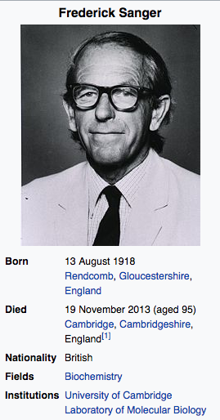
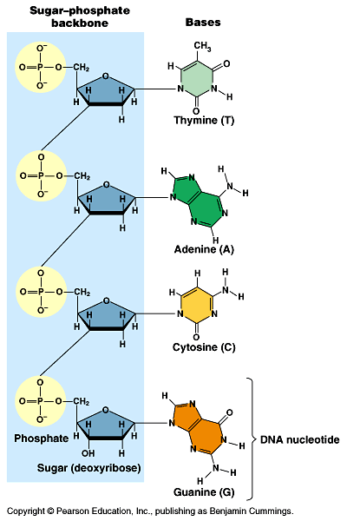
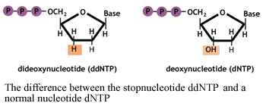
Sanger DNA Sequencing
5’
CHAIN TERMINATOR
3’
A 3’ hydroxyl group is essential for chain elongation

Slide 8
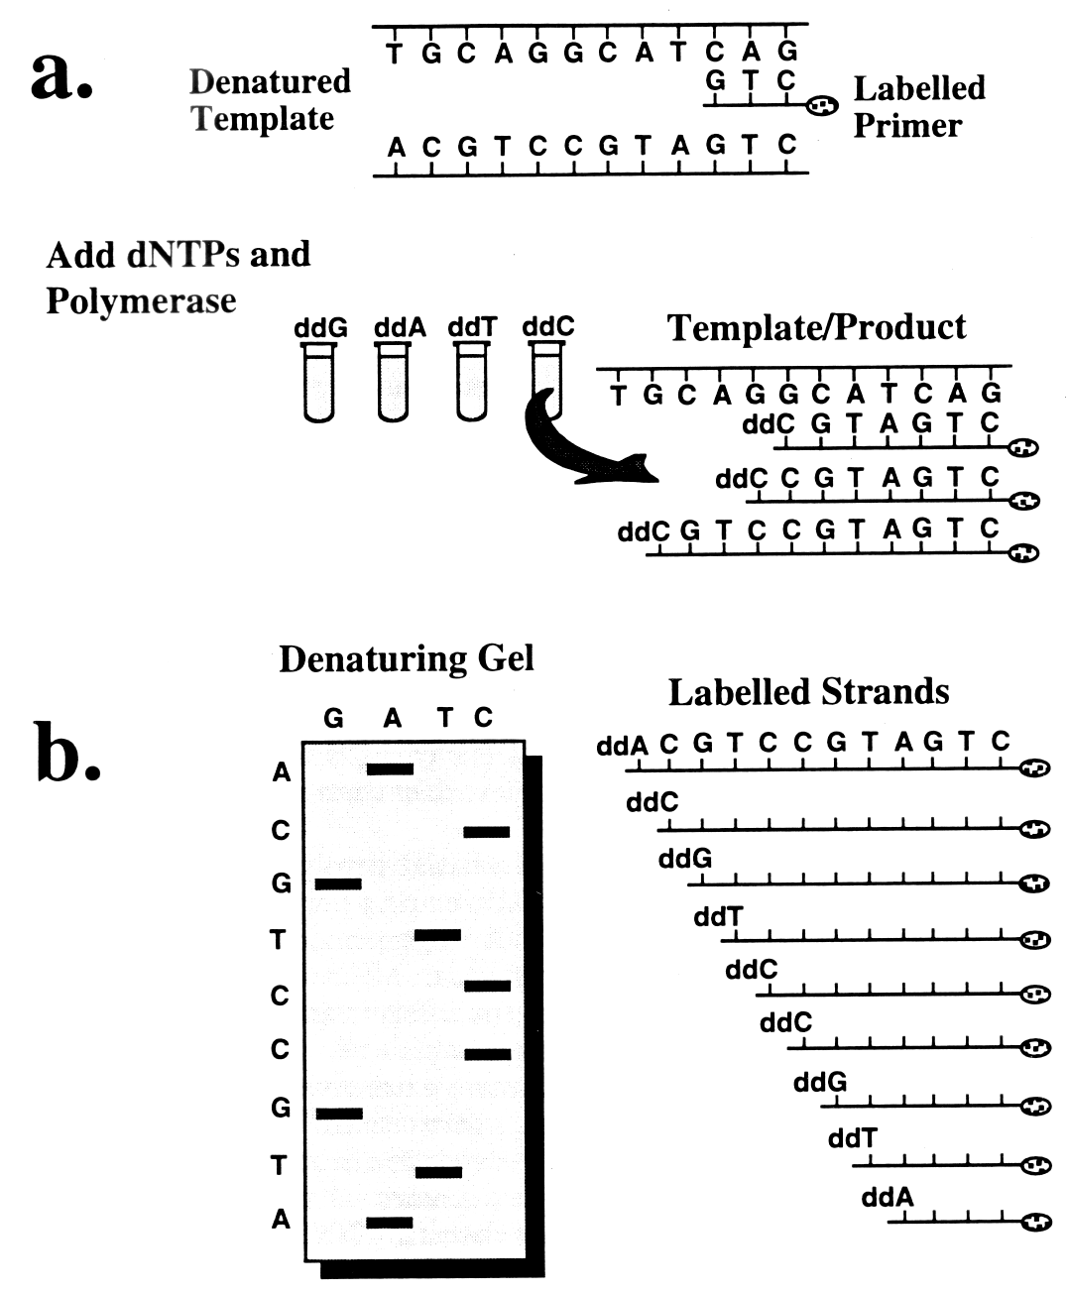
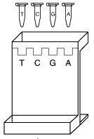
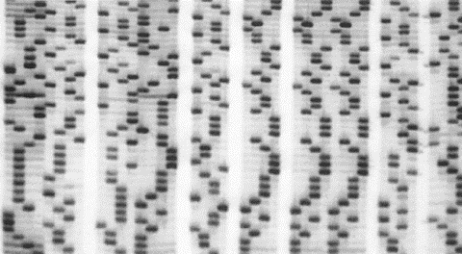
Sanger DNA Sequencing
Denatured
Template
Primer
Run samples on
denaturing
polyacrylamide gel
−
Add dNTPs,
Polymerase,
ddNTP
Template + Product
+
Denaturing gel
Labeled strands
3'
5'
³²P labeled audioradiogram

Slide 9
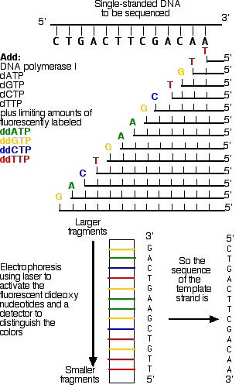
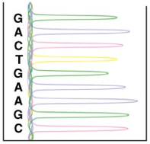
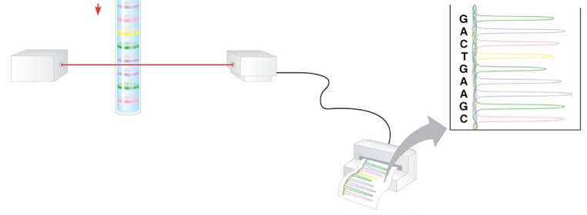
Capillary Gel Electrophoresis
ssDNA to be sequenced
Fluorescent dye vs. radioactive label on dNTPs
Sequencing reaction is performed in a single tube with a mixture of fluorescently labeled ddNTPs
Reaction is electrophoresed in a single denaturing capillary gel (96 samples run at once using robotics)
Different wavelengths emitted by fluorescent dyes are automatically detected upon laser excitation
Computer software automatically reads sequence and assesses quality
3'-
G
A
C
T
G
A
A
G
C
T
G
T
T
-5'
5'-
C
G
A
A
G
T
C
A
G
-3'
Laser
Detector
Trace file

Slide 10
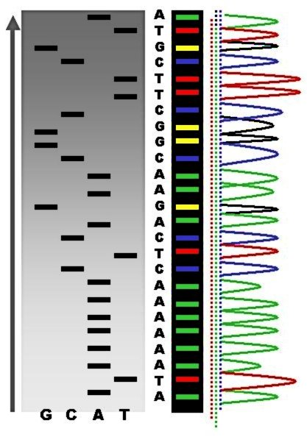
Radioactive vs. Fluorescent Sequencing
³²P-labeled dNTPs
One lane per base
Autoradiogram
4 different fluorophores
Single capillary gel
Laser detector

Slide 11
Automated Sequencing
Perhaps the most important contribution to large-scale sequencing was the development of automated sequencers.
The industry is currently transitioning from Sanger sequencers to second-generation cycle sequencers for large-scale applications.
Automated Sanger sequencers still fill an important niche currently –
but mostly for small-scale applications, like checking that clones contain the expected sequence
Next-gen platforms are currently very expensive
but table-top models will probably be standard laboratory equipment in 5-10 years.
Notes:
Of perhaps paramount value in enabling large-scale sequencing to be performed was the development of automated sequencers. All commercially available machines use the Sanger sequencing methods and fluorescently labeled reaction products. The newer, high-throughput models all use capillary electrophoresis for separation of the reaction products. The two most commonly used instruments are the ABI 3700 and the MegaBACE.

Slide 12
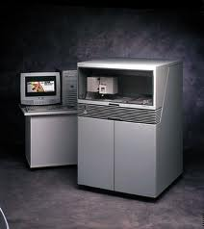
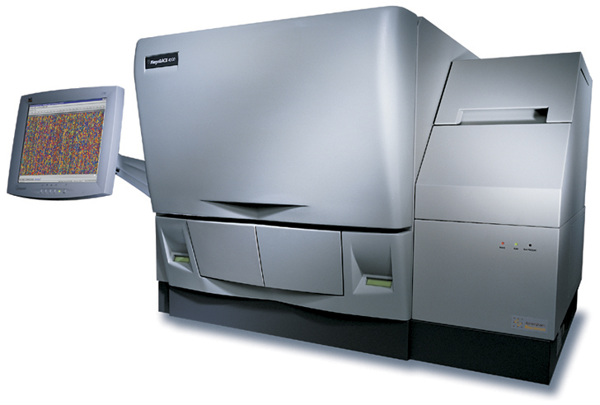
Automated Sequencers
ABI 3700
Made by Applied Biosystems
Most widely used :
96 capillaries
robotic loading from 384-well plates
Two to three hours per run
600–700 bases per read
MegaBACE
Made by Amersham
96 capillaries
Robotic loading from 384–well plate
Two to four hours per run
Up to 800 bases per read
Notes:
The ABI 3700, made by Applied Biosystems, is probably the most widely used instrument for large-scale sequencing. It has 96 capillaries that are fed by robotic loading from two 384-well microtiter plates. It makes a sequence run every two to three hours and can read on average 600–700 bases per run. Celera, the company that produced a rough draft of the human genome in three years, used 200 of these machines running 24/7 to do so.

Slide 13
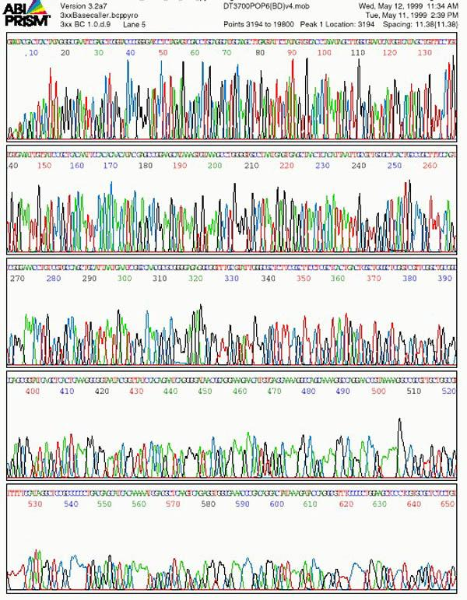
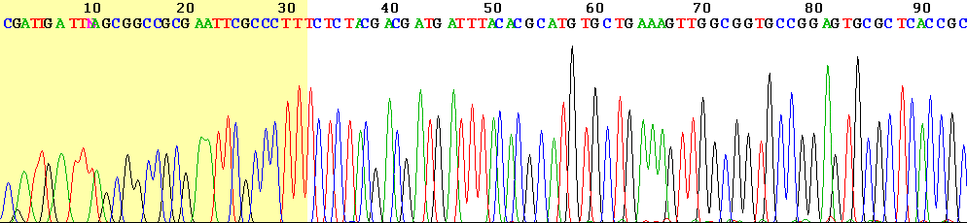
ABI traces
Notes:
Both automated sequencers detect fluorescently labeled DNA strands as they pass through the capillaries. The MegaBACE sequencer uses the confocal imaging system shown in the top image. The readout is given as peaks of fluorescence, as shown in the lower image.

Slide 14
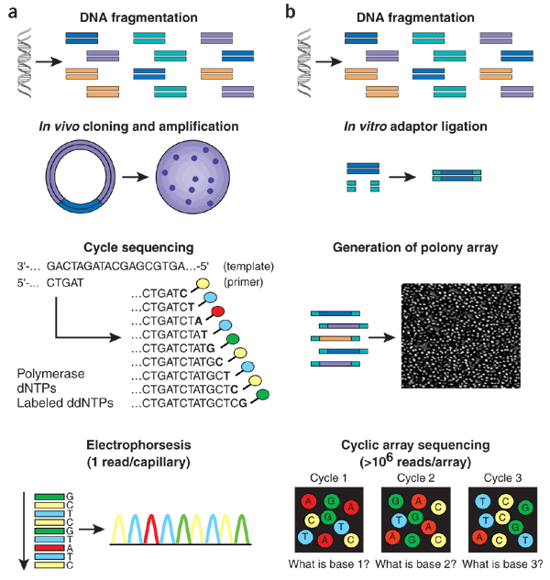

Workflow of conventional vs. second-generation sequencing
High-throughput shotgun Sanger sequencing
Cyclic array shotgun sequencing
Template amplification
(Template amplification)
Template immobilization
Sanger cycle seq
Capillary electrophoresis
Seq by synthesis or hybridization
96 or 384 long reads per run
Millions of short reads per run
Notes:
(a) With high-throughput shotgun Sanger sequencing, genomic DNA is fragmented, then cloned to a plasmid vector and used to transform E. coli. For each sequencing reaction, a single bacterial colony is picked and plasmid DNA isolated. Each cycle sequencing reaction takes place within a microliter-scale volume, generating a ladder of ddNTP-terminated, dye-labeled products, which are subjected to high-resolution electrophoretic separation within one of 96 or 384 capillaries in one run of a sequencing instrument. As fluorescently labeled fragments of discrete sizes pass a detector, the four-channel emission spectrum is used to generate a sequencing trace. (b) In shotgun sequencing with cyclic-array methods, common adaptors are ligated to fragmented genomic DNA, which is then subjected to one of several protocols that results in an array of millions of spatially immobilized PCR colonies or 'polonies'¹⁵. Each polony consists of many copies of a single shotgun library fragment. As all polonies are tethered to a planar array, a single microliter-scale reagent volume (e.g., for primer hybridization and then for enzymatic extension reactions) can be applied to manipulate all array features in parallel. Similarly, imaging-based detection of fluorescent labels incorporated with each extension can be used to acquire sequencing data on all features in parallel. Successive iterations of enzymatic interrogation and imaging are used to build up a contiguous sequencing read for each array feature.

Slide 15
Workflow of conventional vs. second-generation sequencing
High-throughput shotgun Sanger sequencing
Cyclic array shotgun sequencing
Template amplification
(Template amplification)
Template immobilization
Sanger cycle seq
Capillary electrophoresis
Seq by synthesis or hybridization
96 or 384 long reads per run
Millions of short reads per run
Notes:
(a) With high-throughput shotgun Sanger sequencing, genomic DNA is fragmented, then cloned to a plasmid vector and used to transform E. coli. For each sequencing reaction, a single bacterial colony is picked and plasmid DNA isolated. Each cycle sequencing reaction takes place within a microliter-scale volume, generating a ladder of ddNTP-terminated, dye-labeled products, which are subjected to high-resolution electrophoretic separation within one of 96 or 384 capillaries in one run of a sequencing instrument. As fluorescently labeled fragments of discrete sizes pass a detector, the four-channel emission spectrum is used to generate a sequencing trace. (b) In shotgun sequencing with cyclic-array methods, common adaptors are ligated to fragmented genomic DNA, which is then subjected to one of several protocols that results in an array of millions of spatially immobilized PCR colonies or 'polonies'¹⁵. Each polony consists of many copies of a single shotgun library fragment. As all polonies are tethered to a planar array, a single microliter-scale reagent volume (e.g., for primer hybridization and then for enzymatic extension reactions) can be applied to manipulate all array features in parallel. Similarly, imaging-based detection of fluorescent labels incorporated with each extension can be used to acquire sequencing data on all features in parallel. Successive iterations of enzymatic interrogation and imaging are used to build up a contiguous sequencing read for each array feature.

Slide 16
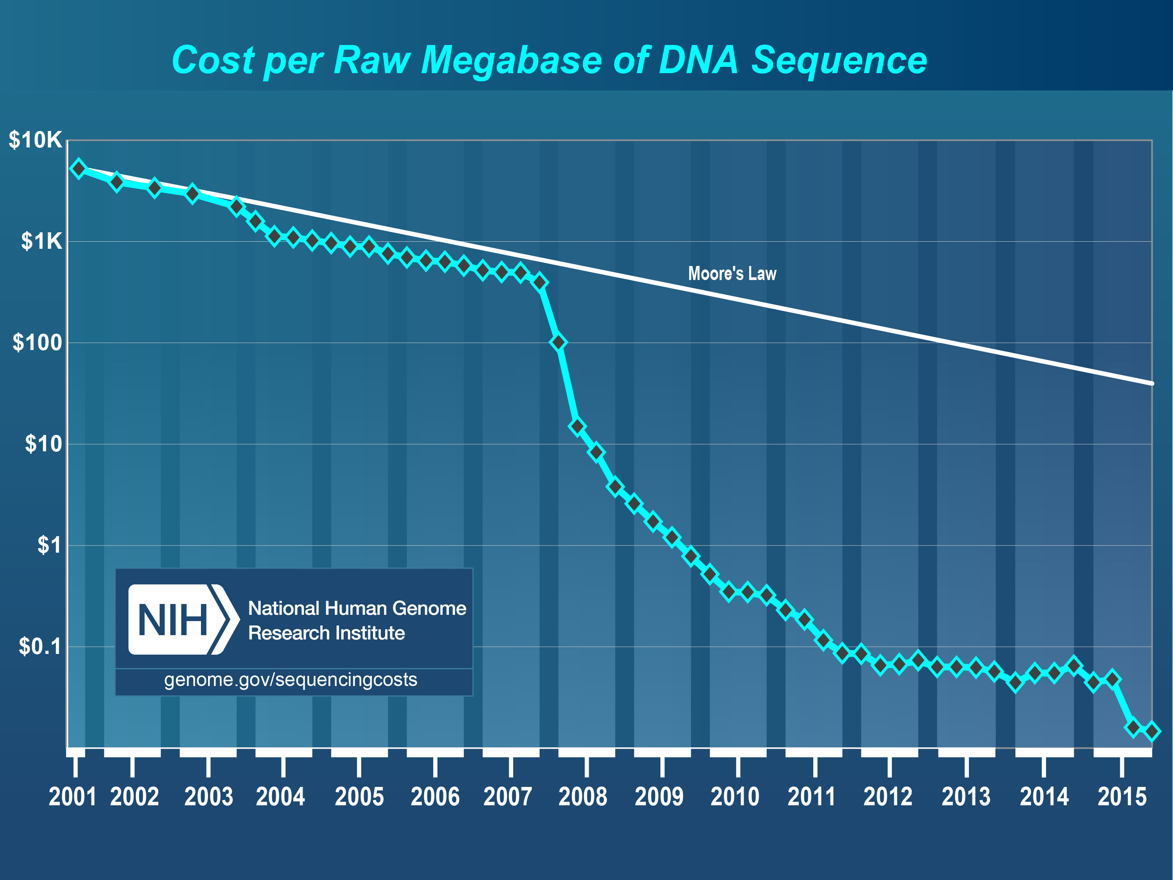
Cost of Sequence per megabase

Slide 17
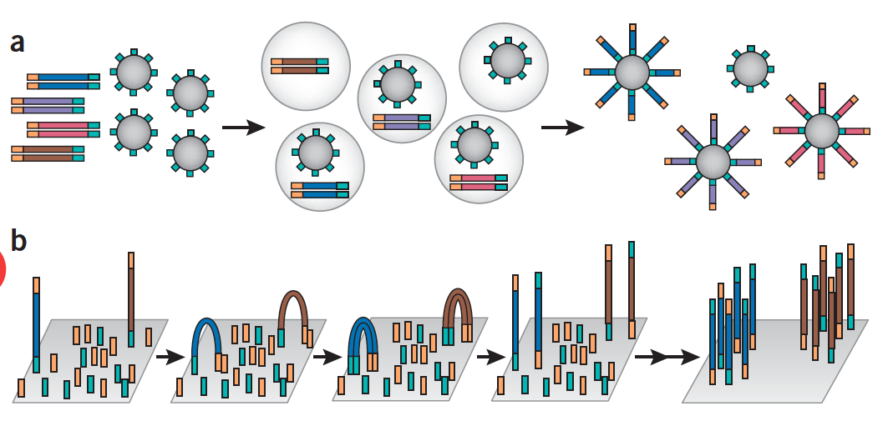
Template Immobilization Strategies

Slide 18
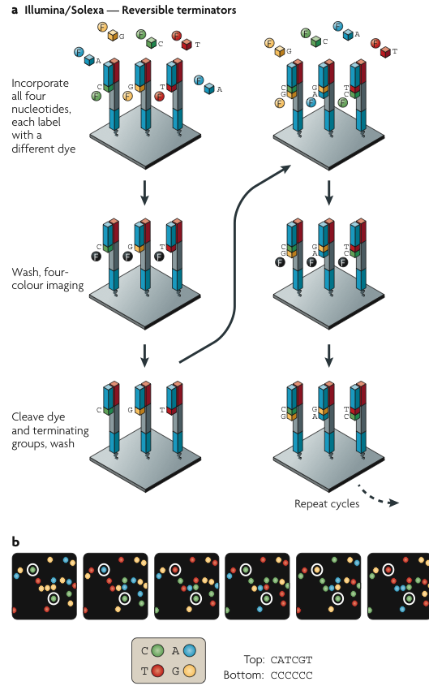
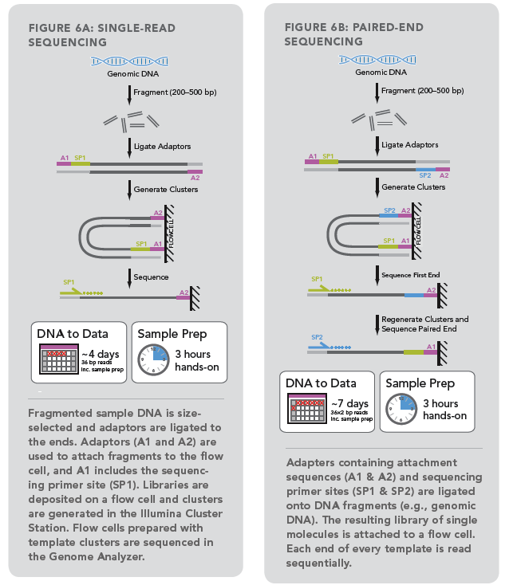
Illumina
Figure from M. Metzker, Nat Rev Genet, Jan. 2010

Slide 19
Illumina video
https://www.youtube.com/watch?v=fCd6B5HRaZ8

Slide 20
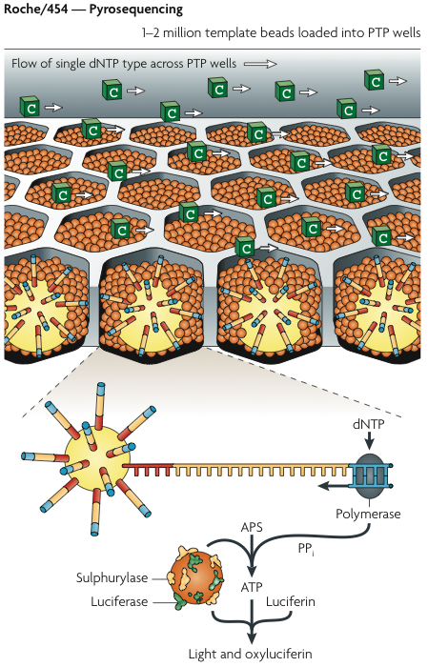
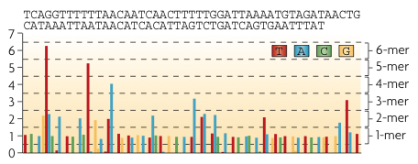
454/Life Sciences
Flowgram
Figure from M. Metzker, Nat Rev Genet, Jan. 2010

Slide 21
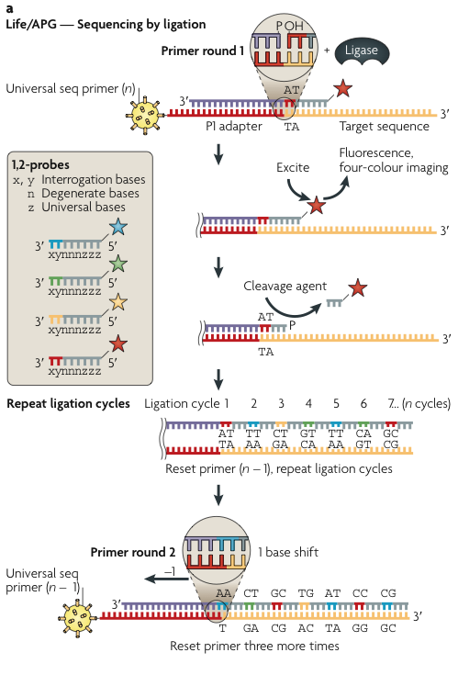
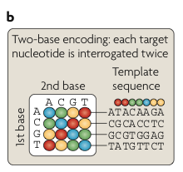
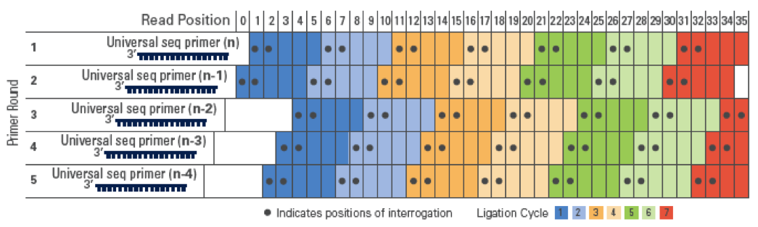
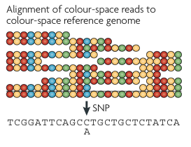
SOLiD
Figure from M. Metzker, Nat Rev Genet, Jan. 2010

Slide 22
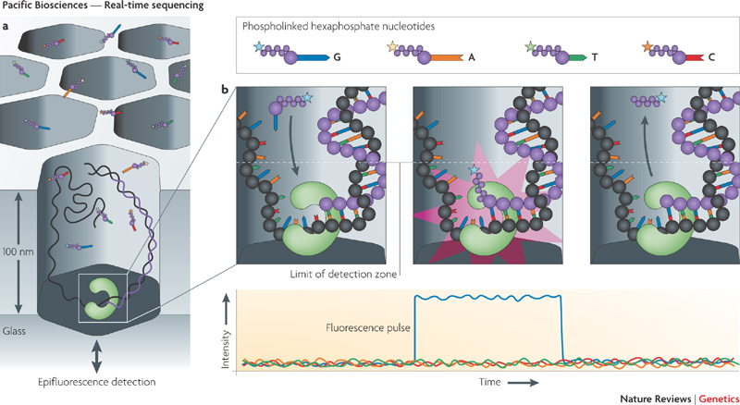
PacBio
Figure from M. Metzker, Nat Rev Genet, Jan. 2010

Slide 23
Pac Bio video
https://www.youtube.com/watch?v=v8p4ph2MAvI

Slide 24
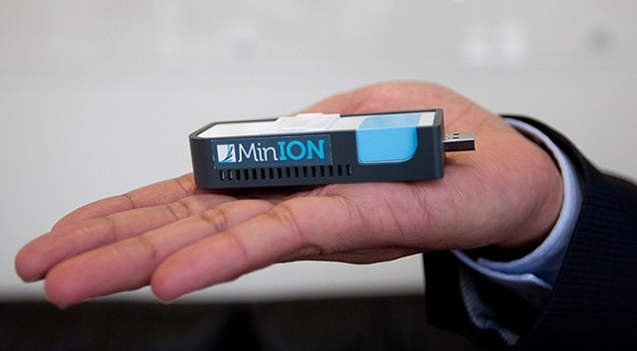
MinION

Slide 25
Nanopore sequencing
https://www.youtube.com/watch?v=sv9fFeSd3kE

Slide 26
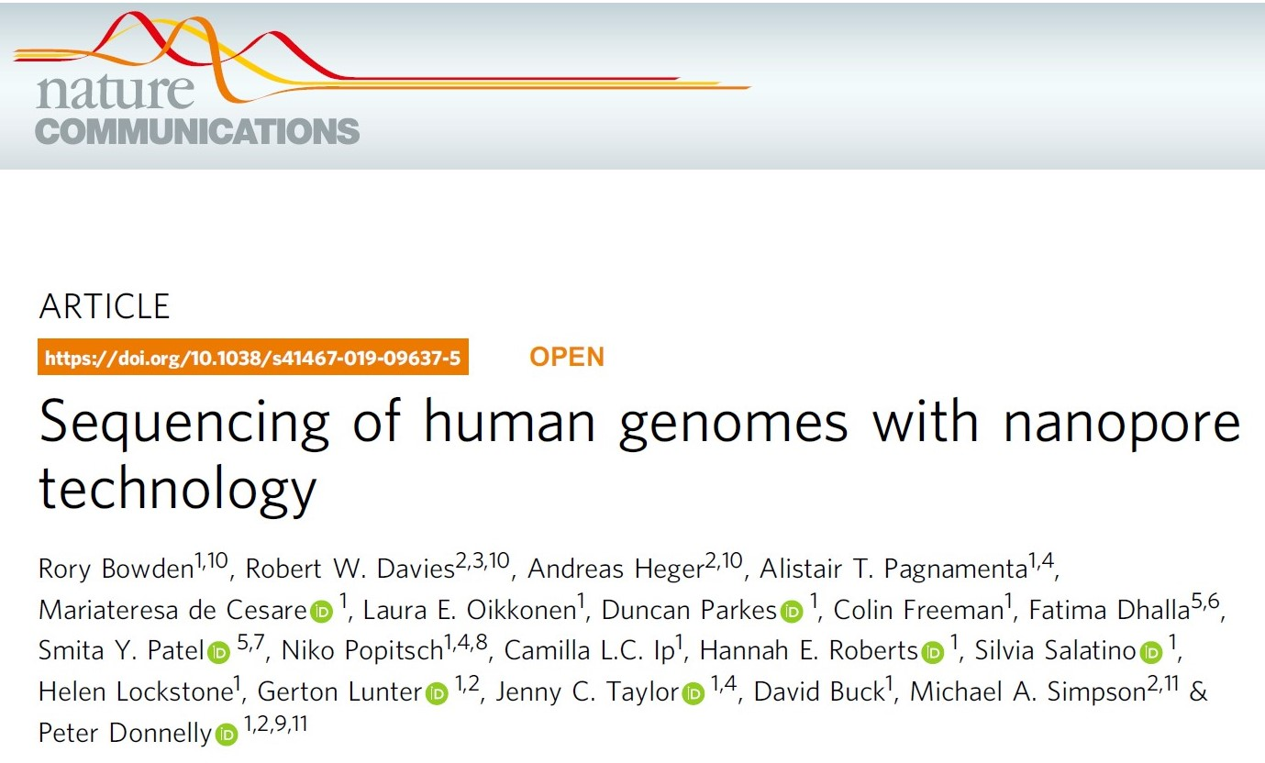

Slide 27
Links to HPC tutorials
Data files
https://learn.gencore.bio.nyu.edu/ngs-file-formats/
HPC on greene
https://sites.google.com/a/nyu.edu/nyu-hpc/systems/greene-cluster
Writing SLURM jobs
https://sites.google.com/a/nyu.edu/nyu-hpc/documentation/prince

Slide 28
Linux and HPC Exercise
Log into greene using jupyterhub on open-on-demand
https://ood-1.hpc.nyu.edu/
Go to your scratch directory
/scratch/<your netid>
Create a directory called agweek2
Copy the following file to your new direcvtory.
/scratch/work/courses/AppliedGenomics2021Sec3/week02/KCL_1.fastq
Check to see the name of the name of the fastqc module
Load the fastqc module
Run fastqc on KCL_1.fastq
Export the notebook as an HTML file.
Transfer the output files of fastqc and the html file from your notebook to the desktop on your computer.
Open the HTML files.

